Slide 1
Maintaining Healthy Weight in Children with ASD: Strategies for Picky Eaters and Mealtime Rigidity
Karen Park, OTD, OTR/L, SWC, CLE
October 17, 2014
The HELP Group Summit 2014

Slide 2
Learning Objectives
Describe multiple interrelated factors that influence the occupation of mealtime and the management of healthy weight in children.
To understand the current challenges of maintaining healthy weight in children and adolescents including those in underserved populations.
To understand the unique challenges of maintaining healthy weight in children with special healthcare needs.
To utilize specific strategies to discuss and manage weight with families and children with feeding disorders or selective feeding behaviors.
To explore the interdisciplinary approach to support unique needs of clients with special healthcare needs with feeding disorders.

Slide 3
Eating/Feeding/Swallowing
Eating: The ability to keep and manipulate food/ﬂuid in the mouth and swallow it.
Feeding: The process of setting up, arranging, and bringing food/ﬂuids from the plate or cup to the mouth.
Swallowing: a complicated act in which food, ﬂuid, medication, or saliva is moved from the mouth through the pharynx and esophagus into the stomach.
Notes:
OT Practice Framework

Slide 4

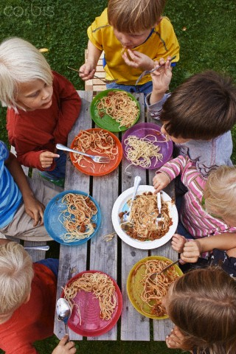



Notes:
Home, school, restaurant, cafeteria, workplace.
Nourishment is essential part of mealtime
But not only physical, but social/emotional
Feeling of connectedness

Slide 5

Mealtime as an Occupation
Communication
Socialization
Context of family, culture, & community
Sharing personal values related to eating
Celebration
Physical growth and health
Sensory exploration
Relaxation
Pleasure and enjoyment
Notes:
Mealtime influences
Communication: sharing of day, current events, personal or family plans
Socialization: learn social skills connected with family, sharing friendships; learning manners and consideration
Culture: traditions or routines around mealtime, traditional foods; also differing beliefs from grandparents to child; ideas about breastfeeding
Celebration: holidays, birthdays
Physical growth: nutrition and nourishment, what is considered healthy
Sensory: experience during meal, smells, tastes, flavors, colors, etc.
Feeding, Eating, Swallowing
Motor Coordination
Sensory Processing
Behavioral Organization/Emotional regulation
Medical Status
Feeding is critical to the infant’s basic survival
Feeding is a primary developmental task
Feeding is a behavior
Feeding is a social and emotional experience
It occurs within the context of the family system
Parents play an important role in all aspects of feeding
Feeding is informed by cultural factors

Slide 6
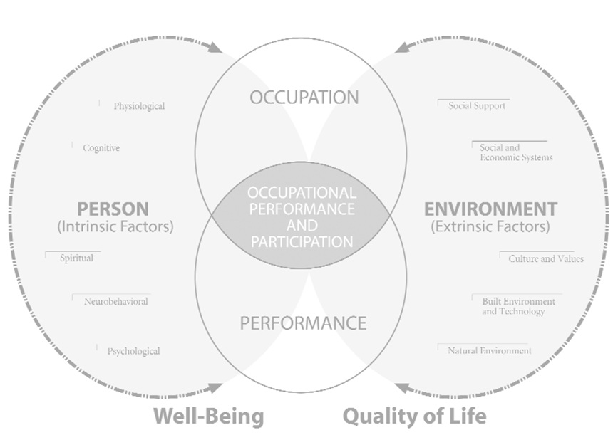
Person-Environment-Occupation (PEO) Model
Law, M., Cooper, B,. Strong, S., Stewart, D., Rigby, P. & Letts, L. 1996. The Person-Environment-Occupation Model: A transactive approach to occupational performance. Canadian Journal of Occupational Therapy. 63(1):9-23
Notes:
Person
The person is a unique being who assumes multiple roles and cannot be separated from contextual influences. The person brings to the context a set of attributes, skills, knowledge and experience. Roles differ and vary in degree of importance depending on the environment and developmental stage of the person. The focus of analysis is on the behaviour of the person, such as:
Motivation: interests, cultural relevance of activity
Consider situations/conditions that precipitate emotional responses: failure, stress, distraction
Degree of autonomy
The basic assumptions of the model are that person is continually developing and is intrinsically motivated.
Environment
The environment is defined as the context within which occupational performance takes place and it is categorized into cultural, socioeconomic, institutional, physical and social. All the environmental categories are equally important to consider according to the model. The environment is considered from the unique perspective of the person, household, neighbourhood and/or community. Demands and cues about expected and appropriate behaviour are received from the environment continuously
Occupation
This is defined as self directed meaningful tasks and activities engaged in throughout a lifespan (Law et al, 1996:16). The model identifies the areas of occupation as self care, productivity and leisure. Occupations are engaged in to satisfy an intrinsic need for self-maintenance, expression, and life satisfaction and they are carried out within multiple contexts in fulfillment of developmentally appropriate roles. The temporal aspects that encompass the occupational routines of the person over time are important to consider.
When analysing occupations the focus should be on characteristics of tasks (occupation), degree of structure, duration of activity, complexity of tasks and characteristics of task demands.

Slide 7
Social Ecological Model
Notes:
social ecological model including individual (maternal circumstances and daily hassles, interpersonal (social supports and networks), organizational (child care, federally funded nutrition programs), and environmental (access and proximity to grocery stores, neighborhood safety, access to parks and recreational facilities).

Slide 8
Prevalence of Feeding Difficulties
Feeding difficulties occur in:
  25% of children in the general population
  Up to 80% of children with severe to profound mental retardation
  More prevalent in children with developmental disabilities, with rates up to 74% (Ledford & Gast, 2006).
  Anecdotal accounts of significant feeding challenges
Notes:
Alan Silverman, PhD Interdisciplinary Care for Feeding Problems in Children, April 2010

Slide 9

Feeding Difficulties in Children with ASD
Behavioral feeding disorders, including aversive eating behaviors
Sensory-based feeding problems
Medical factors
Notes:
Behavioral: food refusal, choking, gagging, and expulsion with no medical basis
Sensory: textural aversions to specific kinds of foods, usually involving the refusal of foods with greater texture or mixed textures
Underlying feeding disorder: aberrant feeding behaviors, maladaptive feeding behavior, problem feeding behavior) in children with ASD as selective acceptance of food or refusal to eat many or most foods with no known medical explanation.

Slide 10

Feeding Disorders and ASD
Child Factors
  Concentration on detail
  Fear of novelty/ritualistic
  Sensory processing impairments
  Deficits in social compliance
  Biological food intolerance
  gut-based, GI factors
**Mealtime Behaviors**
Notes:
Foods touching
Certain utensils used

Slide 11
Feeding Disorders and ASD
Caregiver/Environmental Factors
  Caregiver/family values
  Caregiver attitude towards child’s abilities and challenges
  Reinforcement of negative feeding patterns
  Communication difficulties

Slide 12
Implications of Feeding Disorders
  Nutritional impact and healthy weight
  Attachment may be negatively affected
  Early feeding difficulties persist over time
  Untreated feeding difficulties may evolve into eating disorders in adolescence and adulthood
  Caregivers experience heightened parenting-related stress
Notes:
children with autism spectrum disorders ate about half the number of foods in each food group except starches, where they ate about two thirds the number of foods as typically developing children.
Tactile defensiveness and oral defensiveness may be part of a larger problem in modulating sensory input, which can take different forms. Oral overresponsiveness (defensiveness) may result in difficulty with food textures and, therefore, food selectivity. Oral underresponsiveness, in which the child does not appear to adequately perceive sensations, may result in the child overstuffing his or her mouth.

Slide 13
Role of Occupational Therapist
Understand family’s goals and priorities
Gather information regarding feeding environment, family mealtime routine
Determine current developmental level/feeding skills/swallowing function
Consider interplay of psychosocial, behavioral, and cognitive factors
Quality of life for child and family

Slide 14

Family Centered Care
Viewing child within context of family
Family as the expert on the child’s abilities and needs
Identify strengths
and needs of family
Family works
together to make
informed decisions
Notes:
Family is constant in life of child. Each family is unique, integral and co-equal part of health care team.

Slide 15
Occupational Therapy Assessment
Caregiver interview
Posture and positioning
Motor control related to utensil use and self-feeding skills
Anatomical structures
Neuromotor
Sensorimotor
Respiratory Function

Slide 16
Caregiver Interview
Prenatal care
Birth complications
Surgeries/ hospitalizations
Early feeding history
Developmental milestones
Invasive procedures, including tube feeding or force feeding
Temperament
Other regulatory areas, such as sleeping and toilet training
Previous assessments and evaluations
Notes:
How long has the child experienced difficulties with feeding?
How did the feeding difficulties begin (event, transition, illness)?
Was there a time when the child did not exhibit these difficulties?
Are there others in the family with feeding difficulties?

Slide 17
Caregiver Interview: Family System
Who resides in the home?
Who generally feeds the child?
Is there any difference in the child’s feeding when fed by a different caregiver?
Does the child participate in family mealtime?
Family resources and strengths
Services (school district, Regional Center)
Cultural needs
Family’s goals and expectations

Slide 18
Caregiver Interview: Child Factors
Preferred and non-preferred foods
Preferred and non-preferred flavors and textures
Mealtime schedule and structure
Daily intake
Independent feeding skills
Cues of hunger and satiety
Feeding in different contexts (home, school)

Slide 19
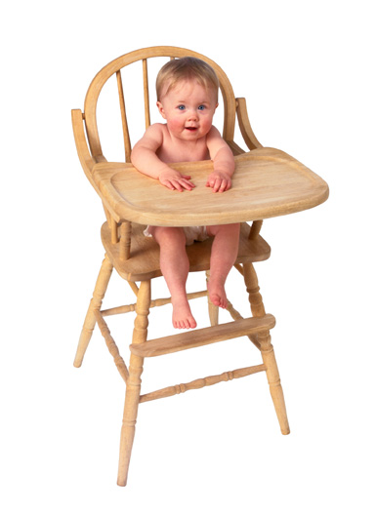
Posture and Positioning
Observation of sitting posture
Positioning
  Lap
  High chair
  Child size chair
Postural control
Strength and endurance

Slide 20
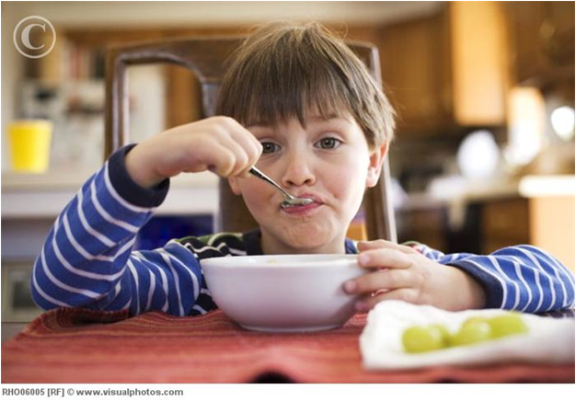
Upper Extremity Motor Control
Finger feeding
Self feeding skills with utensils
  Grasp on utensil
  Coordination and
  efficiency
  Motivation and
  experience
Bilateral
coordination
Notes:
Finger feeding
Utensil use
Cup drinking
Straw drinking
Pacing
Visual motor skills
Bilateral coordination – hands at midline; uses non dominant hand to stabilize; cup drinking, uses one or two hands

Slide 21

Anatomical Structures
Lips
Tongue
Palate
(Hard & Soft)
Jaw
Dentition
Cheeks
Notes:
Lips: cleft, symmetry, shape
Tongue: symmetry, shape, tone
Jaw: small, retracted, protruded, symmetry
Dentition: normal, over/underbite
Cheeks: Tone, symmetry
Palate: (Hard) intact, shape: vault, flat, ridge (soft) function loss of liquid
Functional considerations: management of secretions

Slide 22

Neuromotor
Oral facial muscle tone
Range of motion of
oral structures
Reflexes (rooting,
suck/swallow, gag, cough)
Jaw stability and strength
Chewing
Tongue movements
Lips and cheeks
Notes:
Muscle tone: low, high, fluctuating
ROM
Bite: phasic bite vs mature, sustained controlled bite
Chewing: vertical munching, diagonal movement , rotary chewing
Tongue movements: suckling, protusion, lateralization, tongue tip
Lips: rounding, closure, spreading, management of fluids, drooling?
Cheeks: mobility, range, tone

Slide 23
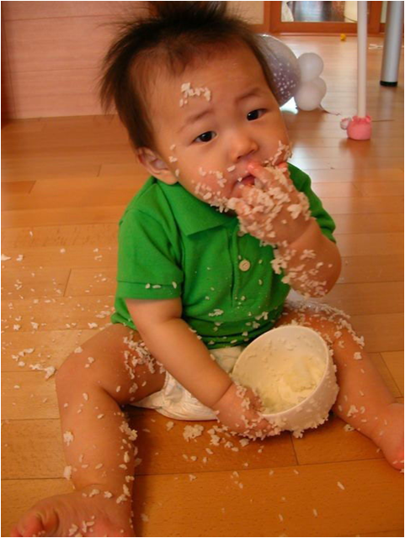
Sensory Processing
Tactile
Proprioceptive
Vestibular
Auditory
Olfactory
Visual
Self-regulation/
Modulation
Notes:
J

Slide 24

Sensorimotor related to Feeding
Response to taste, textures, temperature
Hyper/hypo responsiveness
Sensory
Modulation
Oral praxis
Notes:
Taste: Strong (tart/spicy/salty) flavors, bland, starchy,
Textures: crunchy, smooth, purees, mixed textures, meltables
Temperatures: preferences or aversions to hot, cold, lukewarm

Slide 25
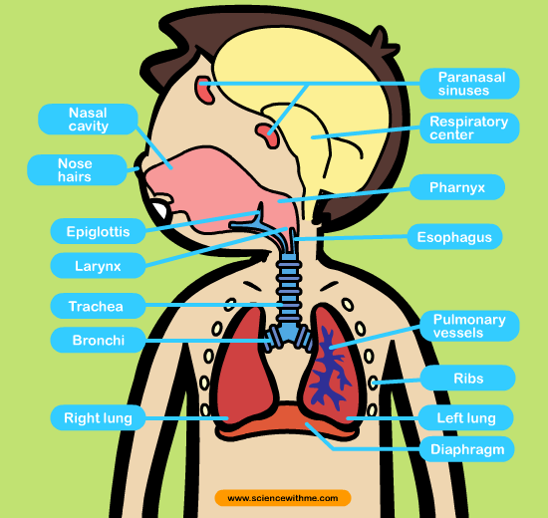
Respiratory Status
Respiration
Vocal Quality
Airway
Protection
Swallow safety
sciencewithme.com
Notes:
Respiration: at baseline and at different points of evaluation: following eating, 10-15 minutes after feeding.
Vocal quality: normal, wet, gurgly
Strength of cough, strength of throat clearing

Slide 26

Feeding Observation: Child Factors
Motivation and interest in feeding
Affect presentation
Eye contact and attentiveness
Ability to remain
calm and regulated during feeding
Anticipation of and
responsiveness to
caregiver prompts
Engages in self-feeding
as developmentally
appropriate

Slide 27
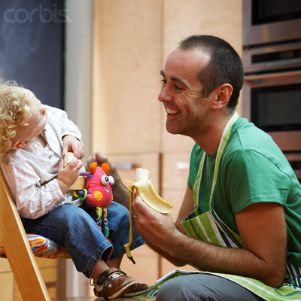
Feeding Observation: Parent Factors
Attunement to child’s cues
Content and tone of mealtime interactions
Pacing of the meal
Feeding expectations
Attentiveness during feeding
Use of prompts and praise to guide feeding
Limit-setting and persistence
Inventiveness

Slide 28

Feeding/Mealtime Goals
Occupational engagement
Identify family’s goals and priorities
Posture and positioning
Self-Feeding/
Self-Care skills
Oral motor skill
development
Sensory processing
Swallowing function
Notes:
Occupational engagement – participation in mealtime, is child isolated, does family eat together, mealtime environment
Family Goals – is it priority to be independent in self feeding, or be able to eat out in restaurants, go over to friends homes, etc.
Posture, alignment – need for additional support during feeding. Does child have poor endurance and fatigue during mealtimes. Need for adaptive seating and improve postural control
Self-Feeding – utensil use, fine motor/UE motor control, developmentally appropriate for child
Oral motor skills development – chewing efficiency, jaw stability and strength for ultimate goal for safety with age appropriate food textures
Sensory processing – sensory modulation, self regulation, proprioceptive/body awareness to maintain seated during mealtime, tactile: tolerance and awareness
Swallowing function: oral prep and oral transit stages, initiation and safety with textures.

Slide 29
Feeding/Mealtime Goals
Pleasurable parent-child interactions at meals
Structure and routine of meals
Parent coping and management of child’s behavior
Desired behavior at mealtimes
Increase oral intake or variety of accepted foods
Expand texture of food acceptance

Slide 30
Feeding Interventions
Oral Sensory Exploration
  NUK brush - Ice/cold temperatures
  Z-Vibe - Sour flavors
  Chewy Tubes - Lollipops
  Textured spoons - Spicy flavors
  Whistles - Dips, dressings, condiments
  Toothettes - Chewy/gummy candy
  Swirly straws
  Facial massage/textured cloth

Slide 31
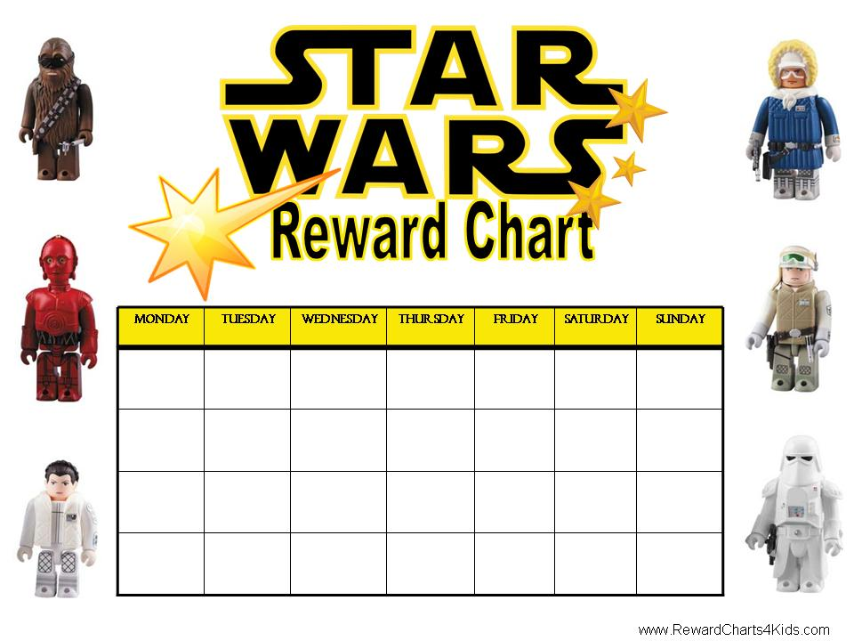
Positive Behavioral Strategies
Shaping desired feeding behaviors using positive reinforcements
  Sticker charts
  Verbal Praise
  Positive Affect
  Positive gestures
  Singing
  Playful interactions
Notes:
Modeling
Narrating
Engagement
Remain calm (language, tone, body language)

Slide 32

Playful Engagement with Food
Offer preferred with non-preferred foods on the same plate
Try it! Touch, smell, kiss, lick, bite and spit out
Food shopping
Food preparation

Slide 33



Food Play/Food Crafts
Food presentation (cut into shapes, characters, cookie cutters)
Put food on skewers or toothpicks
Build things using food
Videos/songs/books about food
Food Games/Toys
Finger painting with purees,
sauces, yogurt, or pudding
Make a food face or necklace

Slide 34

Structuring Family Mealtimes
Environmental Controls
  Safe, clean, nurturing
  Food portion sizes
  Consistent time and place
  15-30 minute meals
  Limits
  Meal preparation and presentation
  Food selections
  Everyone participates
Notes:
Television is off
Charts with time of meals/snacks

Slide 35
Feeding Approaches
Beckman: Oral Motor Therapy
Toomey: The S.O.S. (Sequential Oral Sensory) Approach to Feeding
Fraker, Walbert & Cox: Pre-chaining© and Food Chaining©
Gray: Social Story™
Dunn Klein: Get Permission Trust to Approach to Mealtimes and Sensory Treatment
Notes:
SOS Approach: focuses on increasing a child’s comfort level by exploring and learning about the different properties of food and allows a child to interact with food in a playful, non-stressful way, beginning with the ability to tolerate the food in the room and in front of him/her; then moving on to touching, kissing, and eventually tasting and eating foods
Food Chaining: To address severe picky eating and expand repertoire of accepted foods in a fun, enjoyable way, expand flavor of foods before textures. Going at child’s pace
Social story: describes a situation, skill, or concept in terms of relevant social cues, perspectives, and common responses in a specifically defined style and format.
The goal of a Social Story™ is to share accurate social information in a patient and reassuring manner that is easily understood by its audience. Although the goal of a Story™ should never be to change the individual’s behavior, that individual’s improved understanding of events and expectations may lead to more effective responses.

Slide 36
Childhood Obesity Prevalence
Obesity has more than doubled since 1980 worldwide (WHO, 2012)
In 2010 over 40 million children under age 5 were overweight worldwide (WHO, 2012).
16.9% of US children and adolescence considered to be obese between 2009-2010. Rates increasing with adolescent males. (Ogden, et al., 2012).
Between 2003-2006 obesity in 2-5 year olds to be 10.7% among non-Hispanic white, 14.9% among non-Hispanic black and 16.7% among Mexican American children (Taveras, et al., 2010).
Notes:
What the research is telling us:
Obesity on the rise
Greater among males
Ethnic disparities
gestational weight gain, smoking during pregnancy, fetal growth and rapid infant weight gain, infant feeding, daily sleep and daily television viewing during infancy.

Slide 37
Ethnic and Racial Disparities
Increased prevalence in lower economic strata, minority and immigrant populations (Williamson et al., 1990; Foreyt et al., 1996; Lindsay et al., 2009).
Risk for obesity is elevated for individuals who have disabilities, fewer years of education, or poorer economic or job status (CDC, 2006; Wardle, Waller, & Jarvis, 2002).
Obesity rates continue to increase among non-Hispanic Black and Hispanic children & generally higher compared to non-Hispanic White children (Anderson & Butcher, 2006; Zametkin et al., 2004)

Slide 38
Ethnic and Racial Disparities
Youth in low income urban environments in working class African American and Latino communities have two times the rate of obesity compared to White children (Cahill & Suarez-Balcazar, 2009).
Disparities present as early as preschool when comparing two to five year olds (Taveras et al., 2010).

Slide 39
Population at Greater Risk
Higher prevalence of overweight among children and adolescents with special healthcare needs including spina biﬁda, cerebral palsy, Prader-Willi, Down syndrome, muscular dystrophy, brain injury, visual impairments, learning disabilities, ADHD, and autism spectrum disorders (Rimmer et al., 2007, Rimmer et al., 2011).
Adolescents with autism or Down syndrome are 2-3x more likely to be obese (Rimmer et al., 2009).
Prevalence higher among children with developmental disabilities leading to greater obesity related secondary conditions: pain, fatigue, high blood pressure, high blood cholesterol, social isolation, depression and low self-esteem (De, Small & Baur, 2008, Rimmer, Rowland & Yamaki, 2007, Rimmer et al., 2010).

Slide 40
Factors Influencing Obesity Prevalence
Dietary intake, absence of physical education in school based special needs programs and general sedentary behavior (Minihan et al., 2007).
Lack of access to recreation facilities and limited knowledge on how to adapt programs for children with special healthcare needs contribute to limited opportunities for physical activity (Rimmer et al., 2007).
Medication-induced weight gain prescribed to manage behaviors (Stigler et al., 2004; Hellings et al., 2001; Martin et al., 2000).
Notes:
Atypical (second generation) anti-psychotics/anti-depressants (e.g., Risperdal, Abilify, Seroquel, Lexapro)
Associated with weight gain
Changes in regulation of appetite
Metabolic consequence is greater risk for diabetes

Slide 41
Identified Barriers - Parent
Medication side effects
Anxiety/Depression/Emotional eating
Disrupted eating patterns
Picky Eaters/Problem Feeders/Food Selectivity
Sensory processing challenges
  Oral sensory seeking
  Tactile sensory processing
Notes:
Teenage eating behaviors vs. pathology
Grief over loss of loved one;
Operations

Slide 42
Identified Barriers - Parent
Stigma/decreased support system
Time Constraints
Nutrition knowledge
Cultural factors/routines
  Perceptions of health
  Portion sizes
Environmental factors
Notes:
Stigma from family members, not understanding dx and blaming parent/caregiver.
Time – increased medical appointments, time traveling to NPS, bused to school,
Environmental: school lunches, using food/treats as reinforcement. ABA approach.

Slide 43
Person-Environment-Occupation (PEO) Model
Law, M., Cooper, B,. Strong, S., Stewart, D., Rigby, P. & Letts, L. 1996. The Person-Environment-Occupation Model: A transactive approach to occupational performance. Canadian Journal of Occupational Therapy. 63(1):9-23
Notes:
Person
The person is a unique being who assumes multiple roles and cannot be separated from contextual influences. The person brings to the context a set of attributes, skills, knowledge and experience. Roles differ and vary in degree of importance depending on the environment and developmental stage of the person. The focus of analysis is on the behaviour of the person, such as:
Motivation: interests, cultural relevance of activity
Consider situations/conditions that precipitate emotional responses: failure, stress, distraction
Degree of autonomy
The basic assumptions of the model are that person is continually developing and is intrinsically motivated.
Environment
The environment is defined as the context within which occupational performance takes place and it is categorized into cultural, socioeconomic, institutional, physical and social. All the environmental categories are equally important to consider according to the model. The environment is considered from the unique perspective of the person, household, neighbourhood and/or community. Demands and cues about expected and appropriate behaviour are received from the environment continuously
Occupation
This is defined as self directed meaningful tasks and activities engaged in throughout a lifespan (Law et al, 1996:16). The model identifies the areas of occupation as self care, productivity and leisure. Occupations are engaged in to satisfy an intrinsic need for self-maintenance, expression, and life satisfaction and they are carried out within multiple contexts in fulfillment of developmentally appropriate roles. The temporal aspects that encompass the occupational routines of the person over time are important to consider.
When analysing occupations the focus should be on characteristics of tasks (occupation), degree of structure, duration of activity, complexity of tasks and characteristics of task demands.

Slide 44
BodyWorks
U.S. Department of Health and Human Services, Office of Women’s Health
Evidence-based toolkit (English/Spanish) intended for mothers and adolescent girls.
The program uses a train-the-trainer model
10 week sessions to provide parents/caregivers with tools and strategies to improve family eating and activity habits.
To support adolescent girls in reaching and maintaining a healthy weight and to prevent obesity among adolescent girls.
Promote parent self-efficacy
Notes:
Messages: Healthy girls become strong women; parents are an important influence on children’s eating and activity habits; changes takes time by taking a few small steps.
Reason for choosing: Free! Available in Spanish, easily modifiable, behavioral approach aligned well

Slide 45
BodyWorks Modules
Session 1: Introduction, Toolkits, Discussion on Behavior Change, Goal setting
Session 2: Healthy Weight and Risk of Overweight, Emotion and Eating, Food Journals
Session 3: Introduce “Weigh in with Your Progress,” Basics of Healthy Eating
Session 4: Serving Sizes, Fat Facts, Healthy Lunch Choices and Fast Food choices
Session 5: Physical Activity, Limiting Screen Time
Notes:
Session 1: Stages of change – all participants identified as being in the action stage except one that is contemplation. Goal setting: had difficulty making specific goals and knowing how to take steps to make behavior changes. Talked a lot about small behavior changes: more water less soda, wheat bread for white bread, fruit in lunches
Session 2: Risk of overweight chronic health conditions, diabetes, cardiovascular disease, sleep apnea, stroke, psychological factors, self-esteem, bullying, Food journals: patterns of eating behavior.
Session 3: Weigh in: for accountability, support, peer pressure. Basics of healthy eating: food groups.
Session 4: Portions; pacing of meals; Fast food – healthy options, but also portion control
Session 5: What works for you within your daily routine, family structure. Barriers: safety concerns, runners, keeping child regulated.
Snacks:

Slide 46
BodyWorks Modules
Session 6: Goal Setting, Meal Planning and Cooking with family
Session 7: Shopping for meals, reading nutrition labels.
Session 8: Cooking healthy meals using the Recipe Book and eating together.
Session 9: Environmental Checklist, Setting goals for Environmental Issues
Session 10: Influence of Media on body image and food choices
Notes:
Session 6: mid point, time to check in with goals and revise or add new ones as appropriate; each participant had better sense of what was doable and working for their family. Meal Planning form – involve kids and allow a discussion or conversation.
Session 7: Reading nutrition labels. Education on healthier choices, sodium content processed food for preservation, fat content, carbs. Shopping and including children – behavioral outburst, power struggle; shopping on outer edge of market; shopping different.
Session 8: Recipe book and selecting recipes to try with kids. Eating together
Session 9: examining environment. What is available in home, school and community.
Session 10: influences of media; be aware of messages

Slide 47
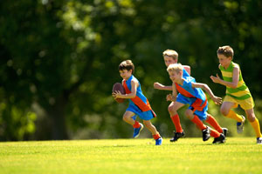
OT’s Role in Addressing Healthy Weight
(Reingold, F.S.& Jordan, K.S. 2013)
Promote engagement in activities that are meaningful and beneficial for physical/mental health and well being.
Improve individual health and quality of life to prevent future disease and disability and promote community health.
Identification of areas of occupational performance challenges in order to develop and implement structured approach to lifestyle change.
  Social participation
  ADL’s
  Education/Work
  Play/Leisure
  Sleep/Rest
Notes:
Social Participation
Difficulty in making and keeping friends due to weight bias
At risk for bullying and social isolation
At risk for mental health disorders such as anxiety depression
May struggle with limited self-esteem and poor body image
ADL
Difficulty in choosing and preparing healthy meals
Education
At risk for decreased enduance and capacity on playground and in PE
Potential decrease in academic performance to social stresses
Work
At risk for experiencing physical and/or social barriers at workplace, such as after school jobs or internships
Play/Leisure
Possible imbalance between sedentary and physical activities
Too much screen time (computer/television) leading to isolation and weight gain
Sleep/Rest
Excessive rest and sleep due to depression and/or low energy levels
Poor sleep patters at night could lead to decreased energy and academic performance

Slide 48
Theoretical Models
Transtheoretical Model (Prochaska & DiClemente, 1983) – Pre-contemplation, contemplation, preparation, action, maintenance.
Self-efficacy – Social Cognitive Theory (Albert Bandura, 1995) “the belief in one’s capabilities to organize and execute the course of action required to manage prospective situations”
Motivational Interviewing (William Miller, 1983) “. . . a collaborative, person-­‐centered form of guiding to elicit and strengthen motivation for change.”

Slide 49
Occupational Therapy Approaches
Sensory Integration Theory (Parham, D., & Mailloux, Z. 2001).
  Clinical frame of reference
  The way the brain organizes sensations for engagement in occupation
  Education on sensory processing
  Sensory-based strategies
Lifestyle Redesign® (Mandel, et al. 1999)
  Restructures thoughts, attitudes and actions through occupational self-analysis, leading to the development of healthier habits and routines.
  See the relationship of doing (activities) to physical and mental health and well-being by increasing the quality and frequency of their self care (ADLs).
  Clients choose and develop their own goals, learn better problem-solving, coping and strategy development skills. Overall lifestyle change – small (and large) changes create radiating effects.
Notes:
Sensory Integration
Certain sensory experience can be calming, others can be dysregulating
These are some common aspects of all of our programs. We’re going to go into each of these in more detail later in the session. I find that students get it faster when they see a specific example. Time Management
Eating Routines
Physical Activity
Stress Management, Relaxation & Sleep
Meaningful Activities
Social Relationships, Support & Community
Pleasure, Play & Leisure
Spirituality
Pacing & Energy Conservation
Motivation
Roles
Attitude & Mood
Daily Habits & Routines
Have a comprehensive background
Use a coordinated, multifaceted approach
Take into account typical life patterns such as:
health status
stress
work /activity demands
sources of motivation and pleasure
Habit Training

Slide 50
OT’s Role in Addressing Healthy Weight
(Reingold, F.S.& Jordan, K.S. 2013)
Promotion
  Whole population approaches fostering mental health and physical health
  Promote health behaviors for all children regardless of size (i.e. nutrition, physical activity, environmental modifications)
Prevention
  Targeted, culturally appropriate interventions focusing on at-risk groups
  Early childhood programs to address physical, psychological, social and spiritual dimensions of a child’s health
  Preventing weight bias and promoting weight tolerance
  Preventing risky behaviors in adolescents and teens
Intensive
  Interventions designed for those who are overweight or obese
  Building habits, engagement in health promoting activities to meet individual goals

Slide 51
Interdisciplinary Approach

Slide 52
Evidence-Based Programs Pediatrics
Population-level Intervention Strategies and Examples for Obesity Prevention in Children. Foltz, May, Belay, Nihiser, Dooyema & Blamck (2012)
Ways to Enhance Children’s Activity and Nutrition (WE CAN) – A Pilot Project with Latina Mothers. James, Connelly, Gracia, Mareno & Baietto (2010)
Outcomes of the 5-4-3-2-1 Go! Community social marketing campaign on obesity risk factors. Evans, Christoffel, Necheles, Becker, Snider (2011)

Slide 53
References
Allison, D. B., Mentore, J. L., Heo, M., Chandler, L. P., Cappelleri, J. C., Infante, M. C., & Weiden, P. J. (1999). Antipsychotic-induced weight gain: a comprehensive research synthesis. American Journal of Psychiatry, 156(11), 1686-1696.
Anderson, P.M. & Butcher, K. F. (2006). Childhood obesity: Trends and potential causes. The Future of Children, 16(1), 19-45.
Anderson, S.E., Cohen, P., Naumova, E.N., Jacques, P.F., & Must, A. (2007). Adolescent obesity and risk for subsequent major depressive disorder and anxiety disorder: Prospective evidence. Psychosomatic Medicine, 69(8), 740-747.
Bandini, L. G., Curtin, C., Hamad, C., Tybor, D. J., & Must, A. (2005). Prevalence of overweight in children with developmental disorders in the continuous National Health and Nutrition Examination Survey (NHANES) 1999-2002. The Journal of pediatrics, 146(6), 738-743.
BeLue, R., Francis, L.A., & Colaco, B. (2009). Mental health problems and overweight in a nationally representative sample of adolescents: Effects of race and ethnicity. Pediatrics, 123(2), 697-702.
Cahill, S.M. & Suarez-Balcazar, Y. (2009). Promoting children’s nutrition and fitneess in the urban context. American Journal of Occupational therapy, 63, 113-116.
Cermak, S., Curtin, C., & Bandini, L.G. (2010). Food Selectivity and Sensory Sensitivity in Children with Autism Spectrum Disorders , Journal of the American Dietetic Association, 110(2), 238–246.
De, S., Small, J., Baur, L.A., (2008). Overweight and obesity among children with developmental disabilities. Journal of Intellectual and Developmental Disability, 33, 43-47.
Ebbeling, C.B, Pawlak, D.B., & Ludwig, D.S. (2002). Childhood obesity: public-health crisis, common sense cure. The Lancet, 360(9331), 473–482.
Goodman, E. & Whitaker, R.C. (2002). A prospective study of the role of depression in the development and persistence of adolescent obesity. Pediatrics, 110(3), 497-504.
Han, J.C., Lawlor, D.A., & Kimm, S.Y. (2010). Childhood obesity. The Lancet, 375(9727), 1737-1748.
Law, M., Cooper, B,. Strong, S., Stewart, D., Rigby, P. & Letts, L. 1996. The Person-Environment-Occupation Model: A transactive approach to occupational performance. Canadian Journal of Occupational Therapy. 63(1):9-23
Ledford, J. R., & Gast, D. L. (2006). Feeding Problems in Children With Autism Spectrum Disorders A Review. Focus on Autism and Other Developmental Disabilities, 21(3), 153-166.
Liou, T. H., Pi‐Sunyer, F. X., & Laferrere, B. (2005). Physical disability and obesity. Nutrition reviews, 63(10), 321-331.

Slide 54
References
Matson, J. L., & Fodstad, J. C. (2009). The treatment of food selectivity and other feeding problems in children with autism spectrum disorders. Research in Autism Spectrum Disorders, 3(2), 455-461.
Minihan, P. M., Fitch, S. N., & Must, A. (2007). What does the epidemic of childhood obesity mean for children with special health care needs?. The Journal of Law, Medicine & Ethics, 35(1), 61-77.
Ogden, C.L., Carroll, M.D., Kit, B.K. & Flegal, K.M. (2012). Prevalence of obesity and trends in body mass index among US children and adolescents, 1999-2010. The Journal of the American Medical Association, 307(5), 483-490.
Parham, D., & Mailloux, Z. (2001). Sensory Integration. In J. Case-Smith (Ed.), Occupational therapy for children (pp. 329-381). Philadelphia: Mosby.
Reingold, F.S., Jordan, K.S. (2013) Obesity and occupational therapy: Position paper.
Rimmer, J. H., Rowland, J. L., & Yamaki, K. (2007). Obesity and secondary conditions in adolescents with disabilities: Addressing the needs of an underserved population. Journal of Adolescent Health, 41(3), 224-229.
Rimmer, J. H., Wang, E., Yamaki, K., & Davis, B. (2009). Documenting disparities in obesity and disability. FOCUS Technical Brief, 24, 1-16.
Rimmer, J. H., Yamaki, K., Lowry, B. M., Wang, E., & Vogel, L. C. (2010). Obesity and obesity‐related secondary conditions in adolescents with intellectual/developmental disabilities. Journal of Intellectual Disability Research, 54(9), 787-794.
Toomey, K. (2013). SOS Approach to Feeding. Retrieved from http://www.sosapproach-conferences.com/about-us/sos-approach-to-feeding
Rimmer, J. H., Yamaki, K., Davis, B. M., Wang, E., & Vogel, L. C. (2011). Peer Reviewed: Obesity and Overweight Prevalence Among Adolescents With Disabilities. Preventing chronic disease, 8(2).
Stigler, K. A., Potenza, M. N., Posey, D. J., & McDougle, C. J. (2004). Weight gain associated with atypical antipsychotic use in children and adolescents.Pediatric Drugs, 6(1), 33-44.
Taveras, E.M., Gillman, M.W., Kleinman, K., Rich-Edwards, J.W. & Rifas-Shiman, S.L. (2010). Racial/ethnic differences in early-life risk factors for childhood obesity. Pediatrics, 125(4): 686-695.
Mandel, D.R., Jackson, J.M., Zemke, R., Nelson, L., & Clark, F.A. (1999). Lifestyle Redesign Implementing the Well Elderly Program. Bethesda: The American Occupational Therapy Association, Inc.
Zametkin, A.J., Zoon, C.K., Klein, H.W., Munson, S., (2004). Psychiatric aspects of child and adolescent obesity: A review of the past 10 years. Journal of the American Academy of Child & Adolescent Psychiatry, 43(2), 134-150.

